Slide 1
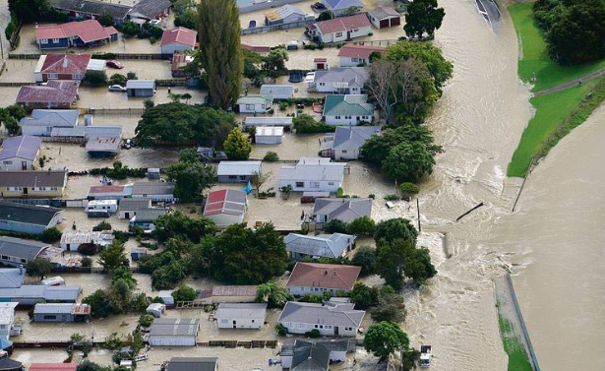
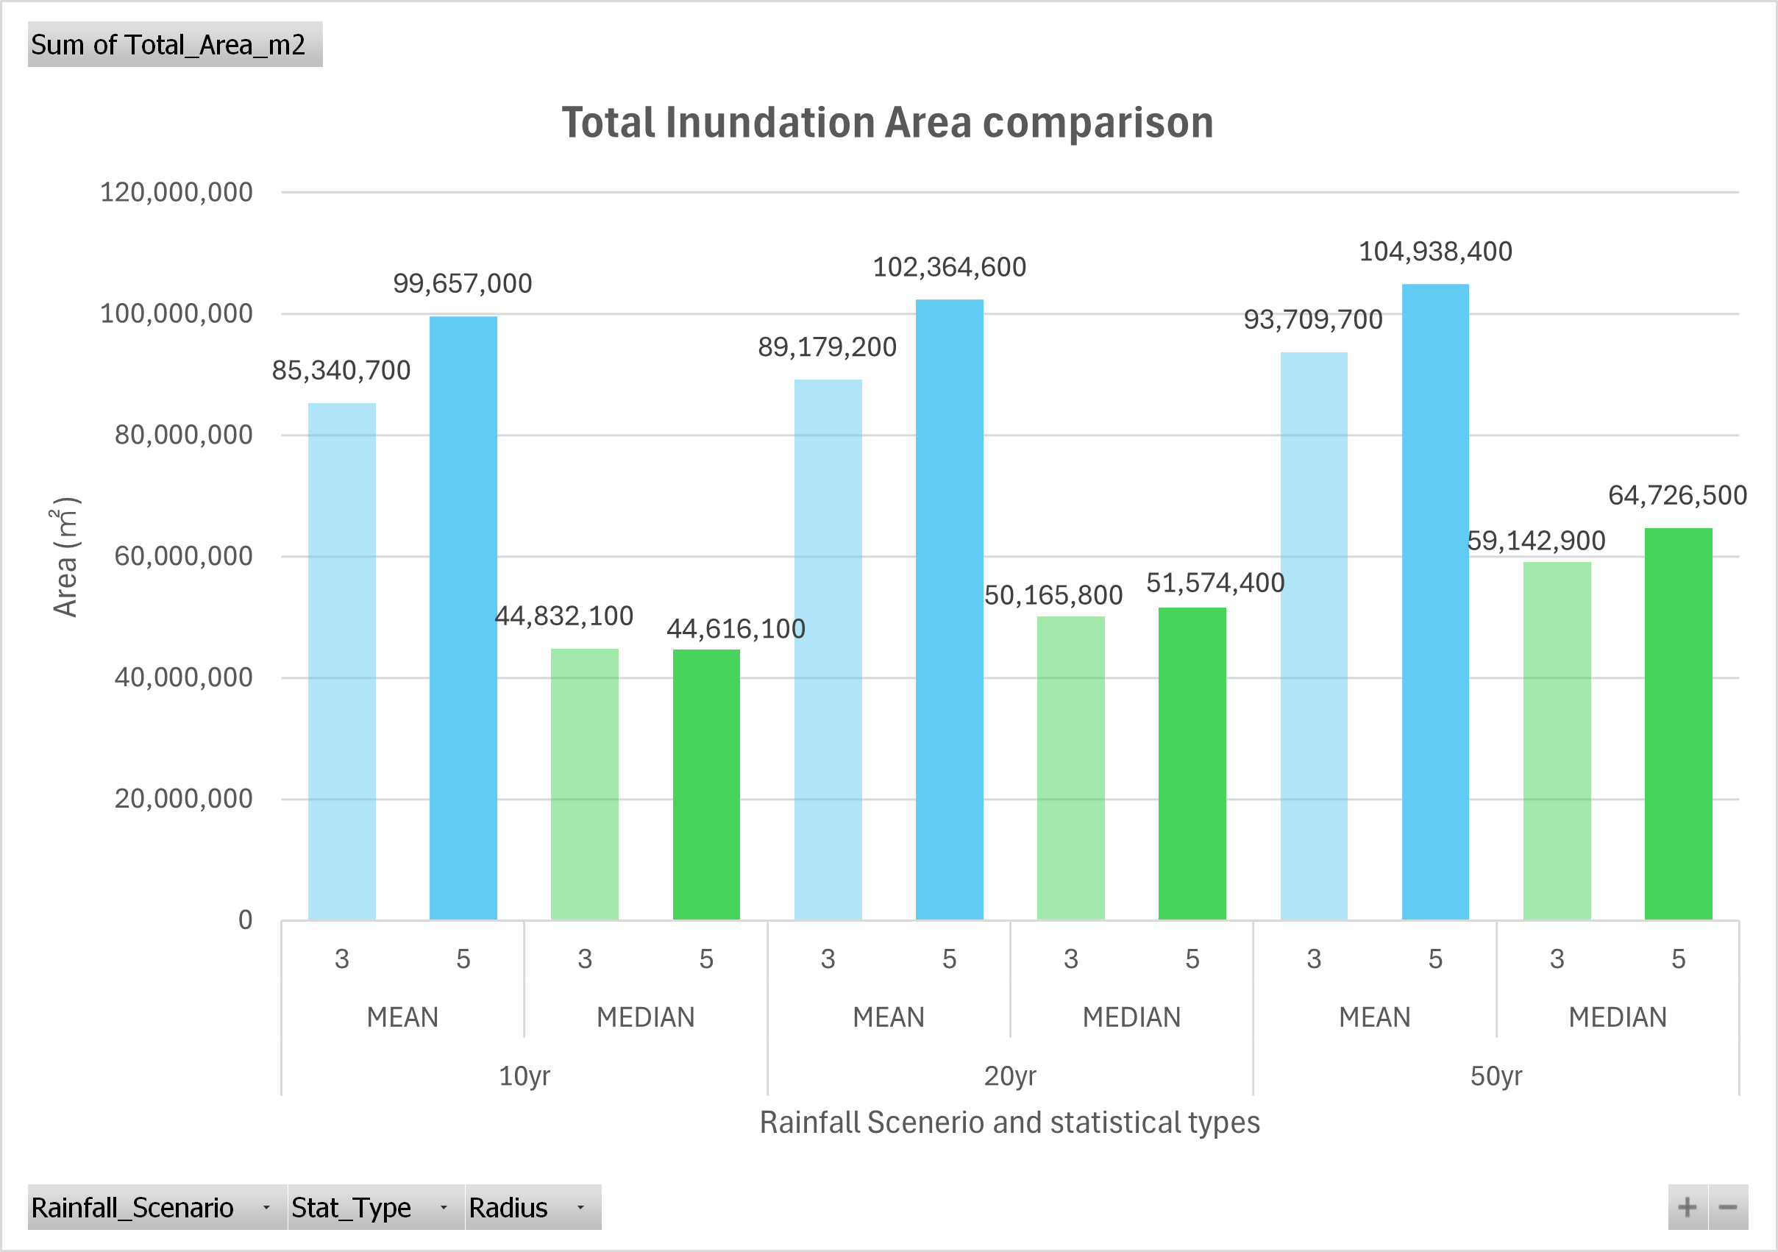
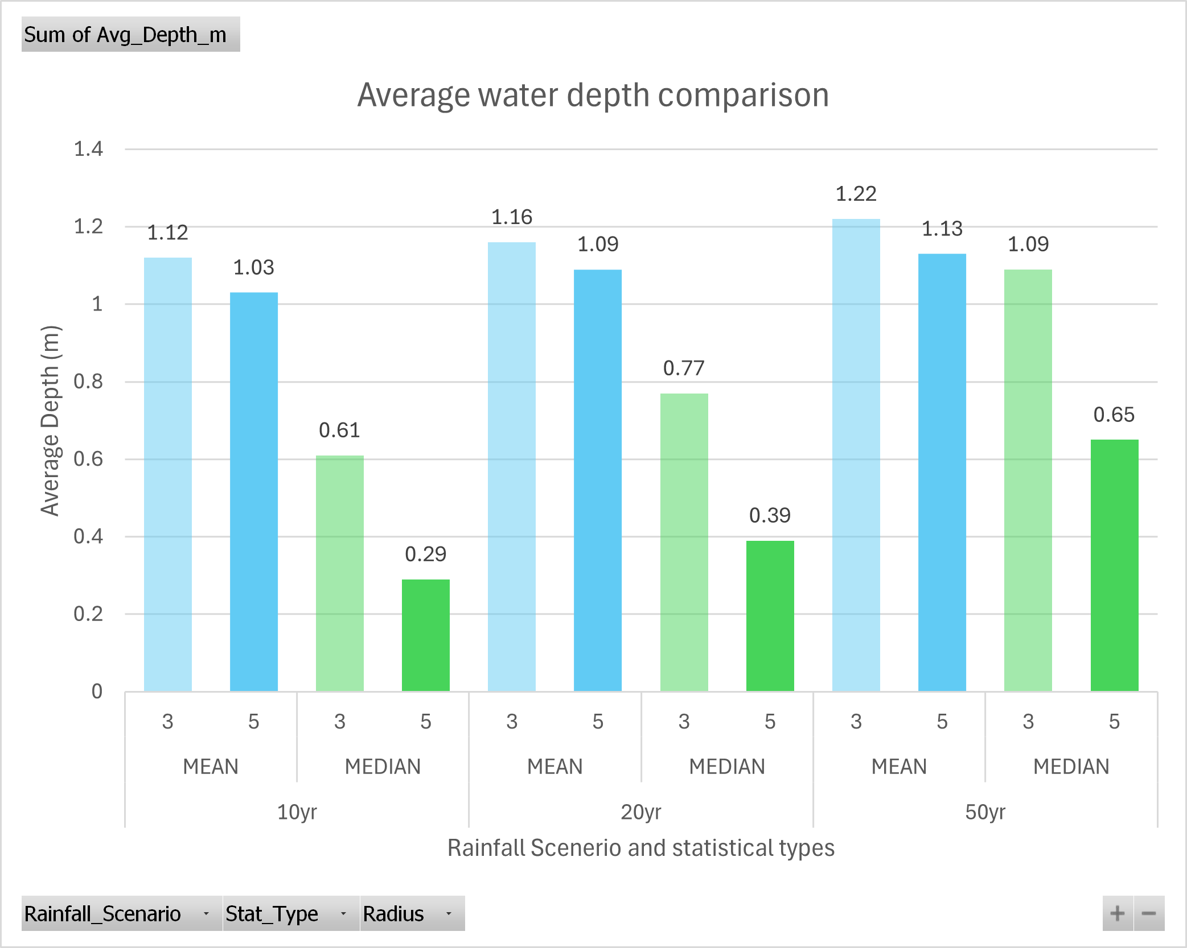
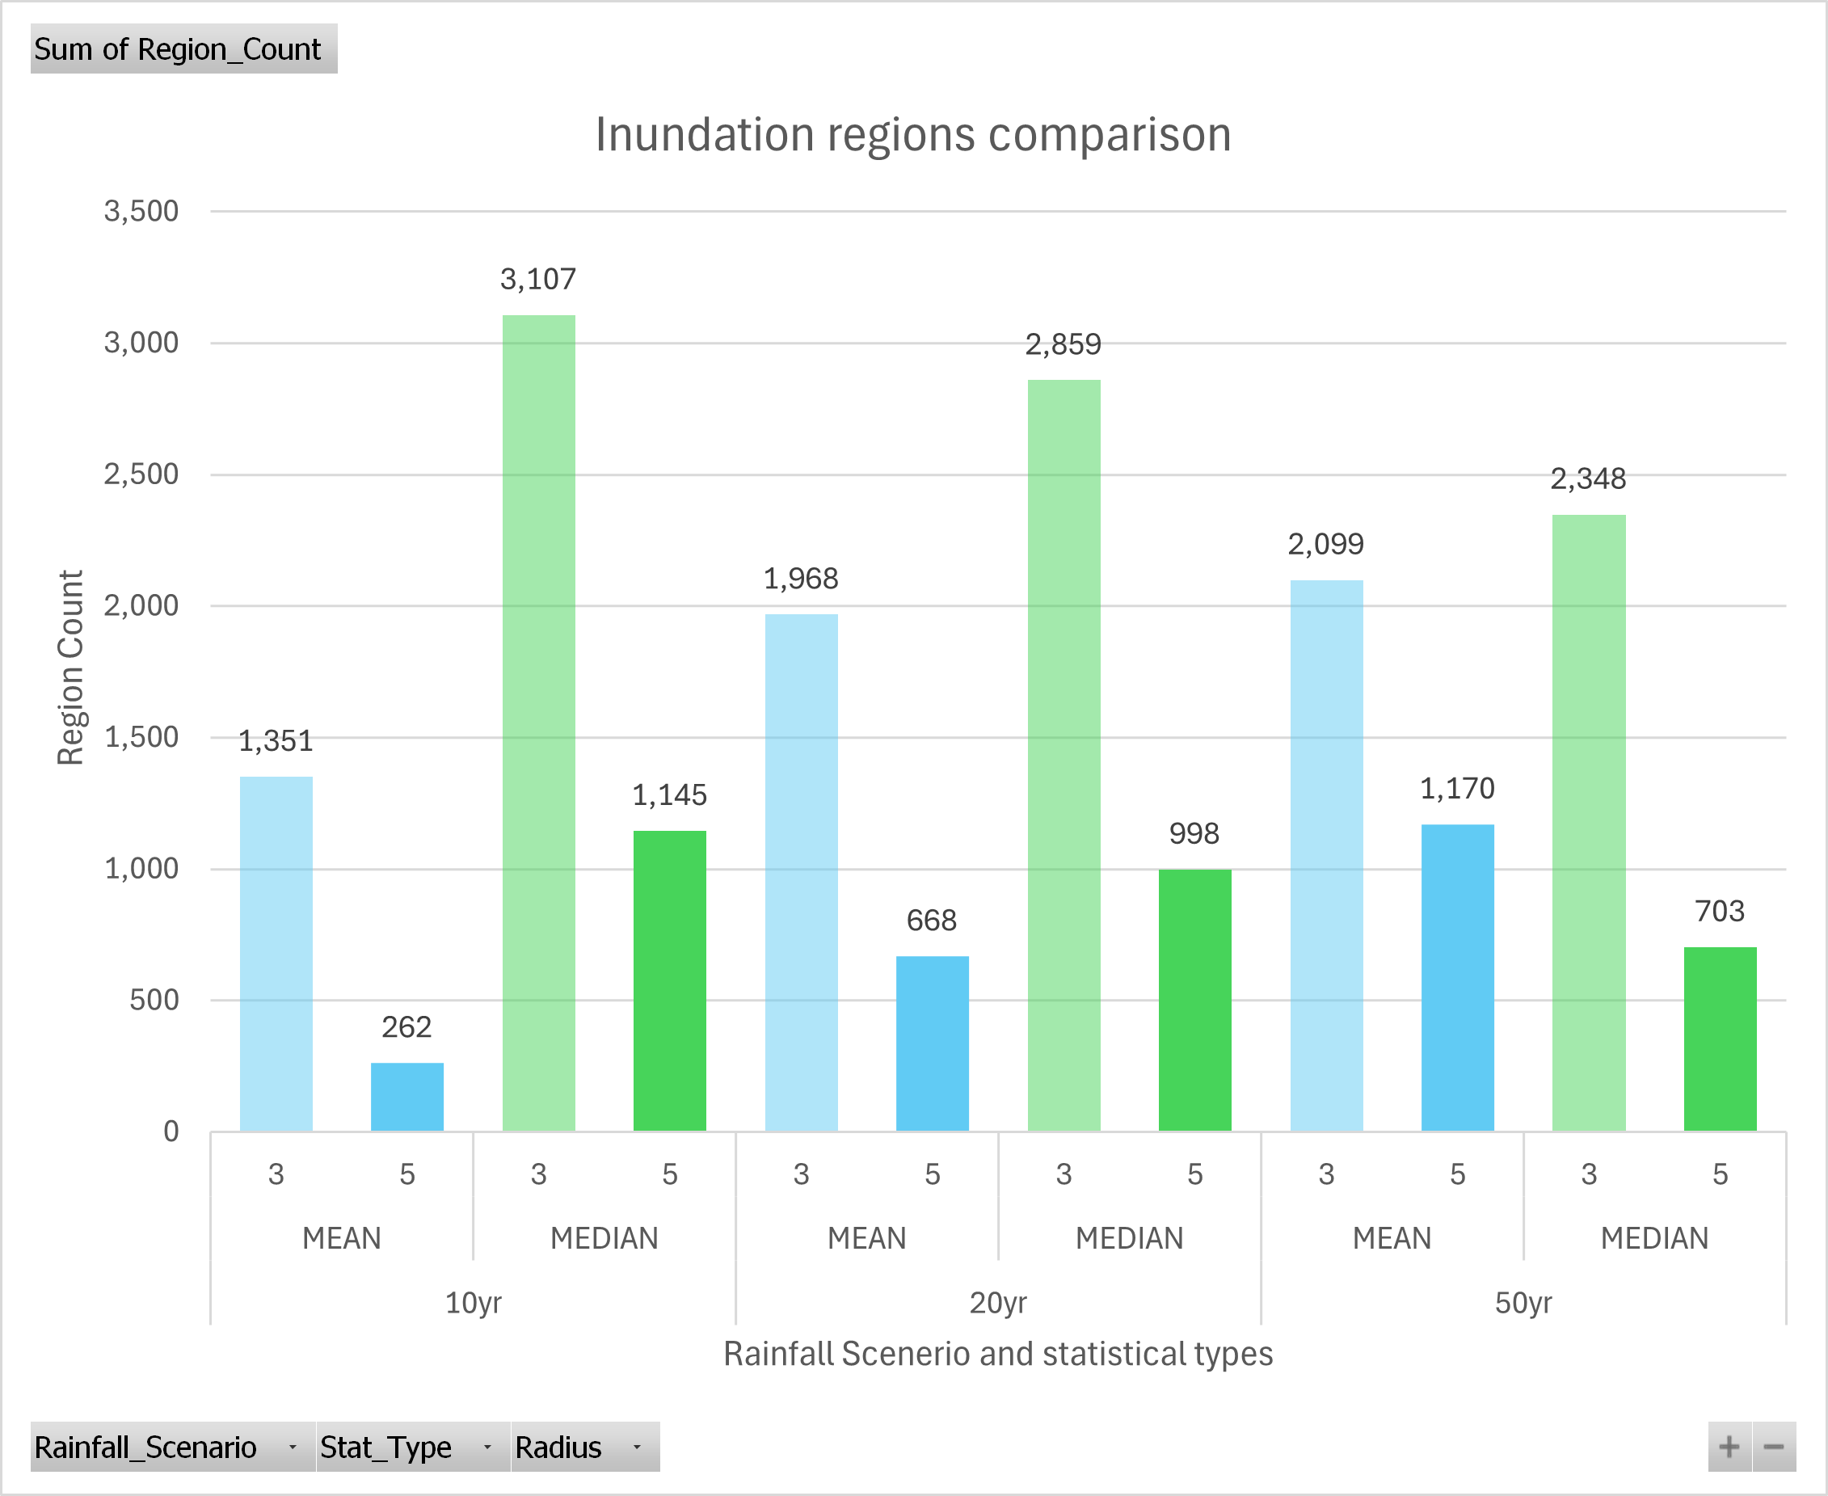
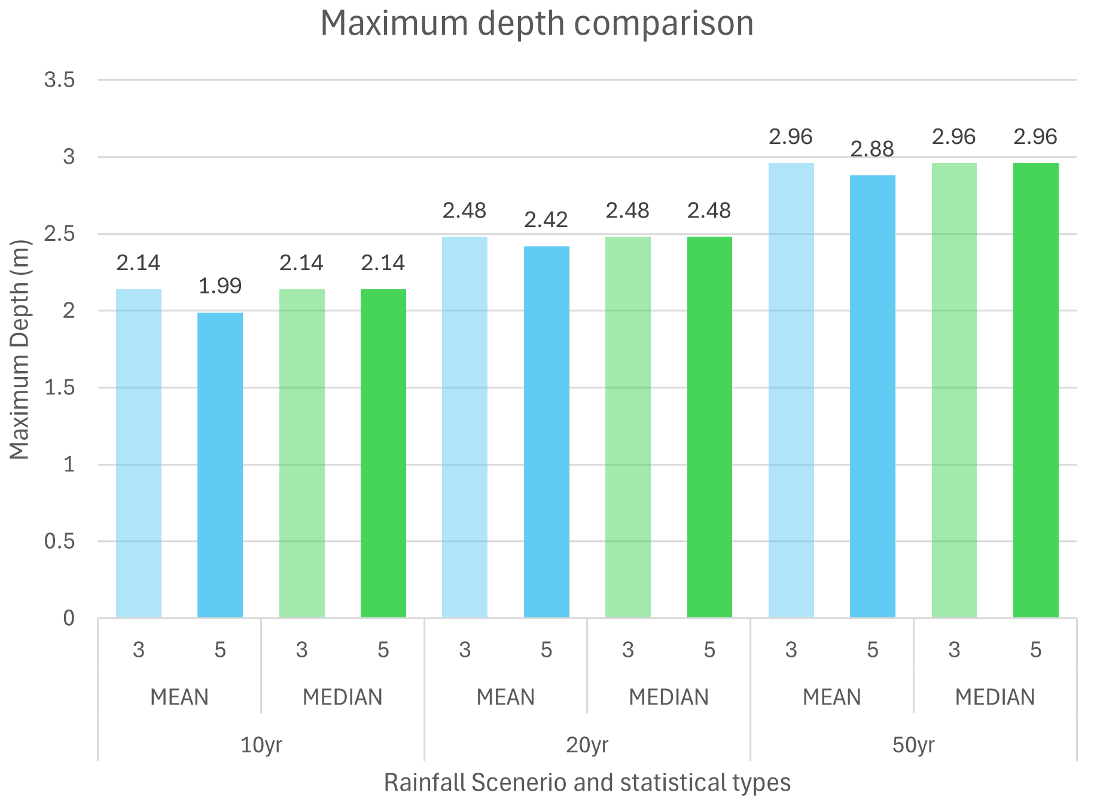
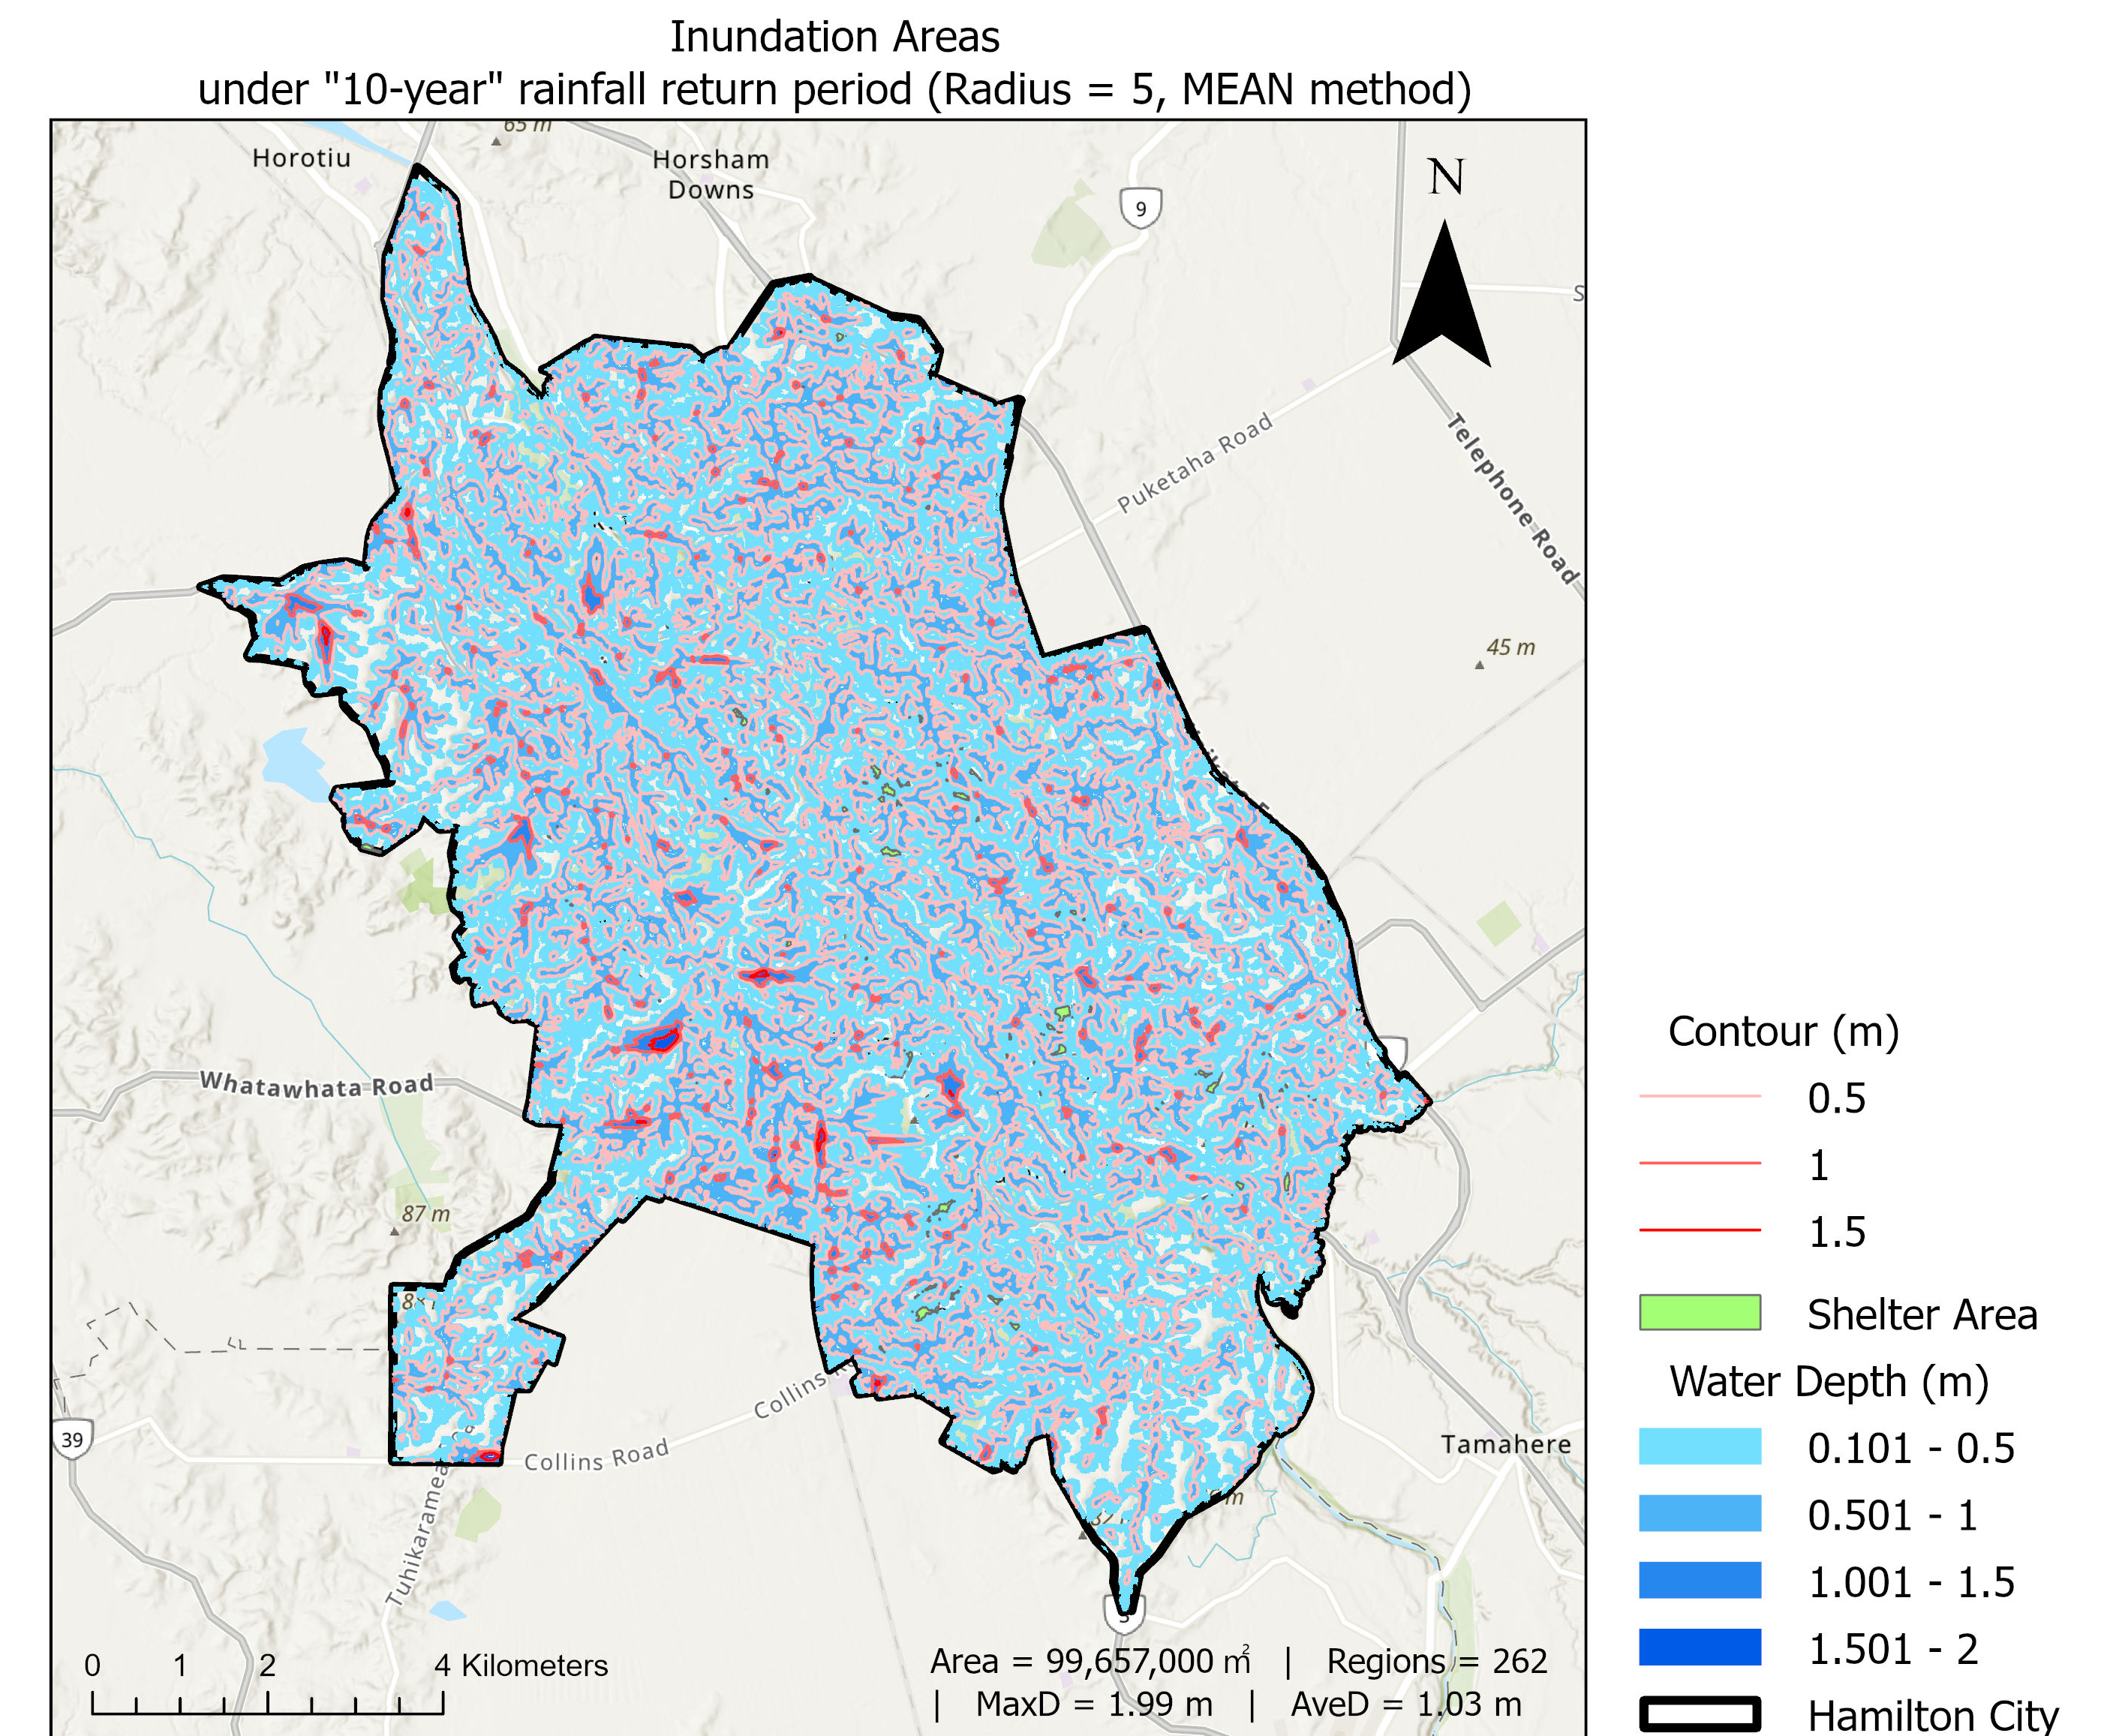
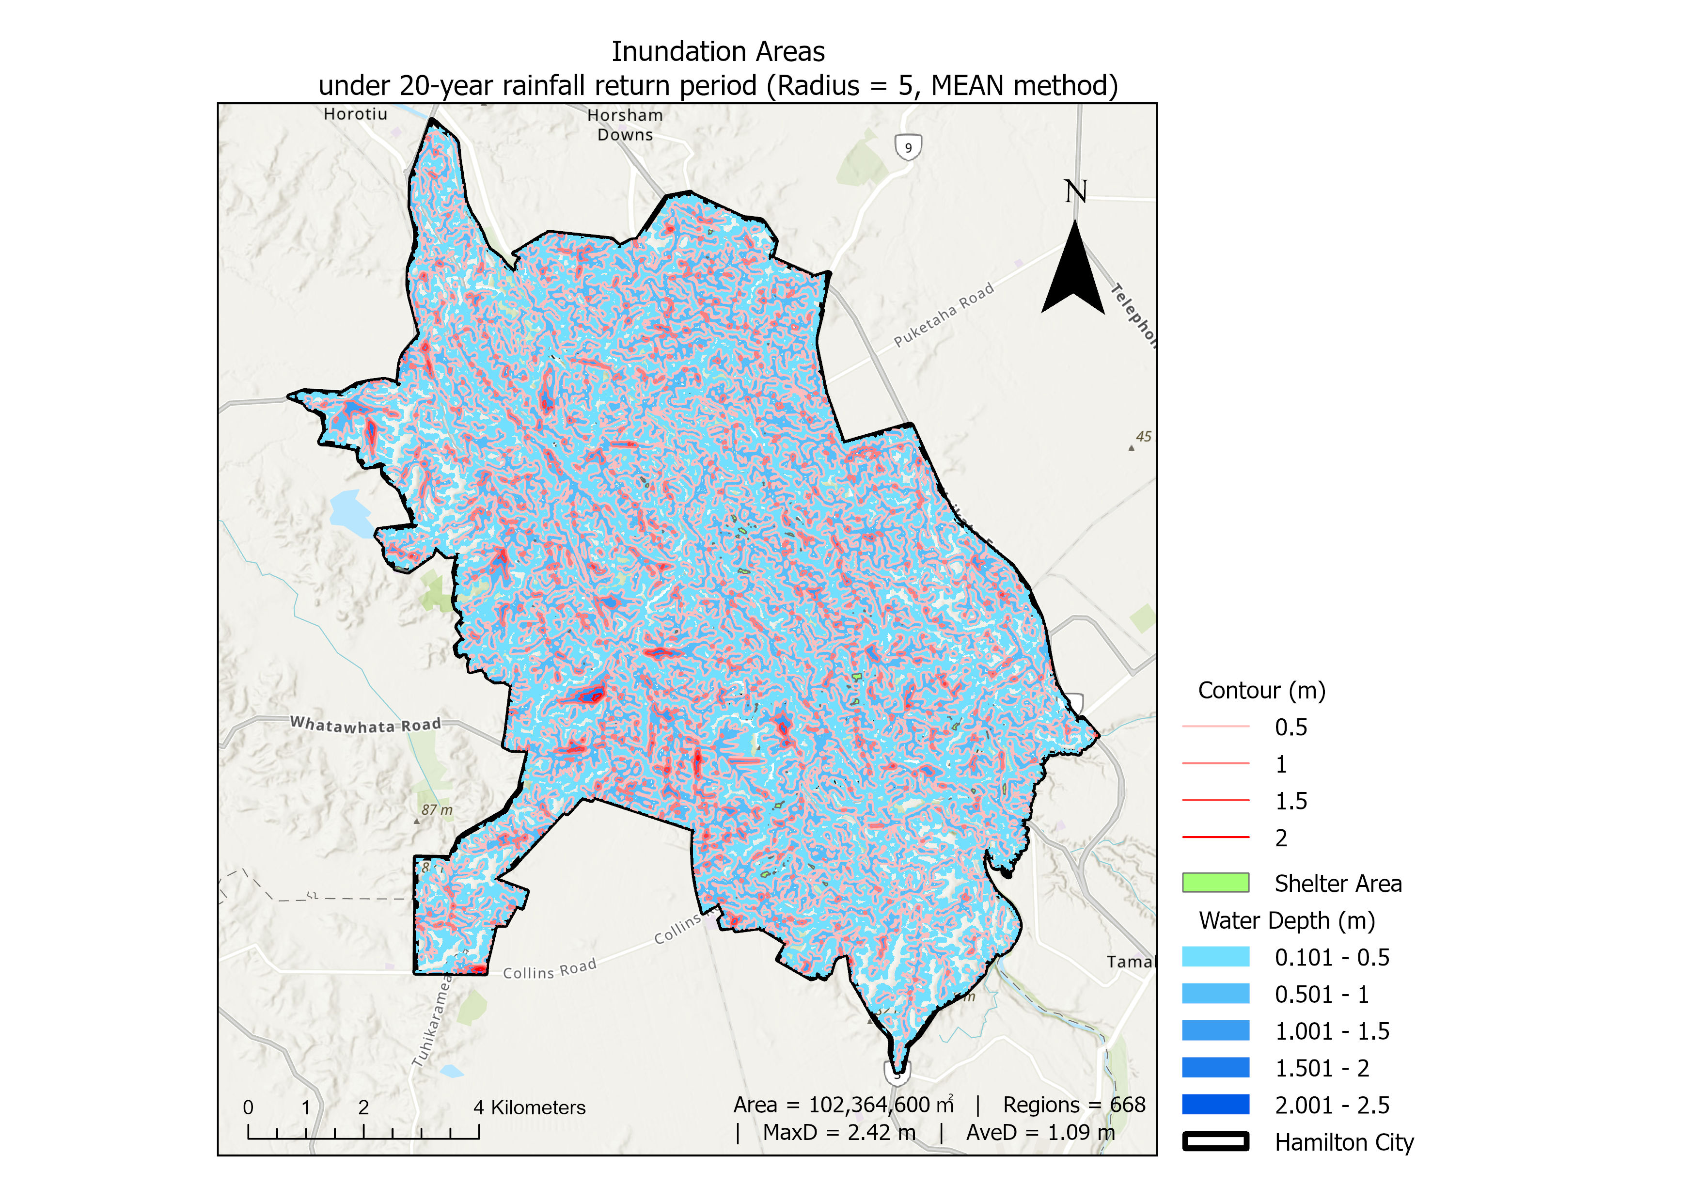
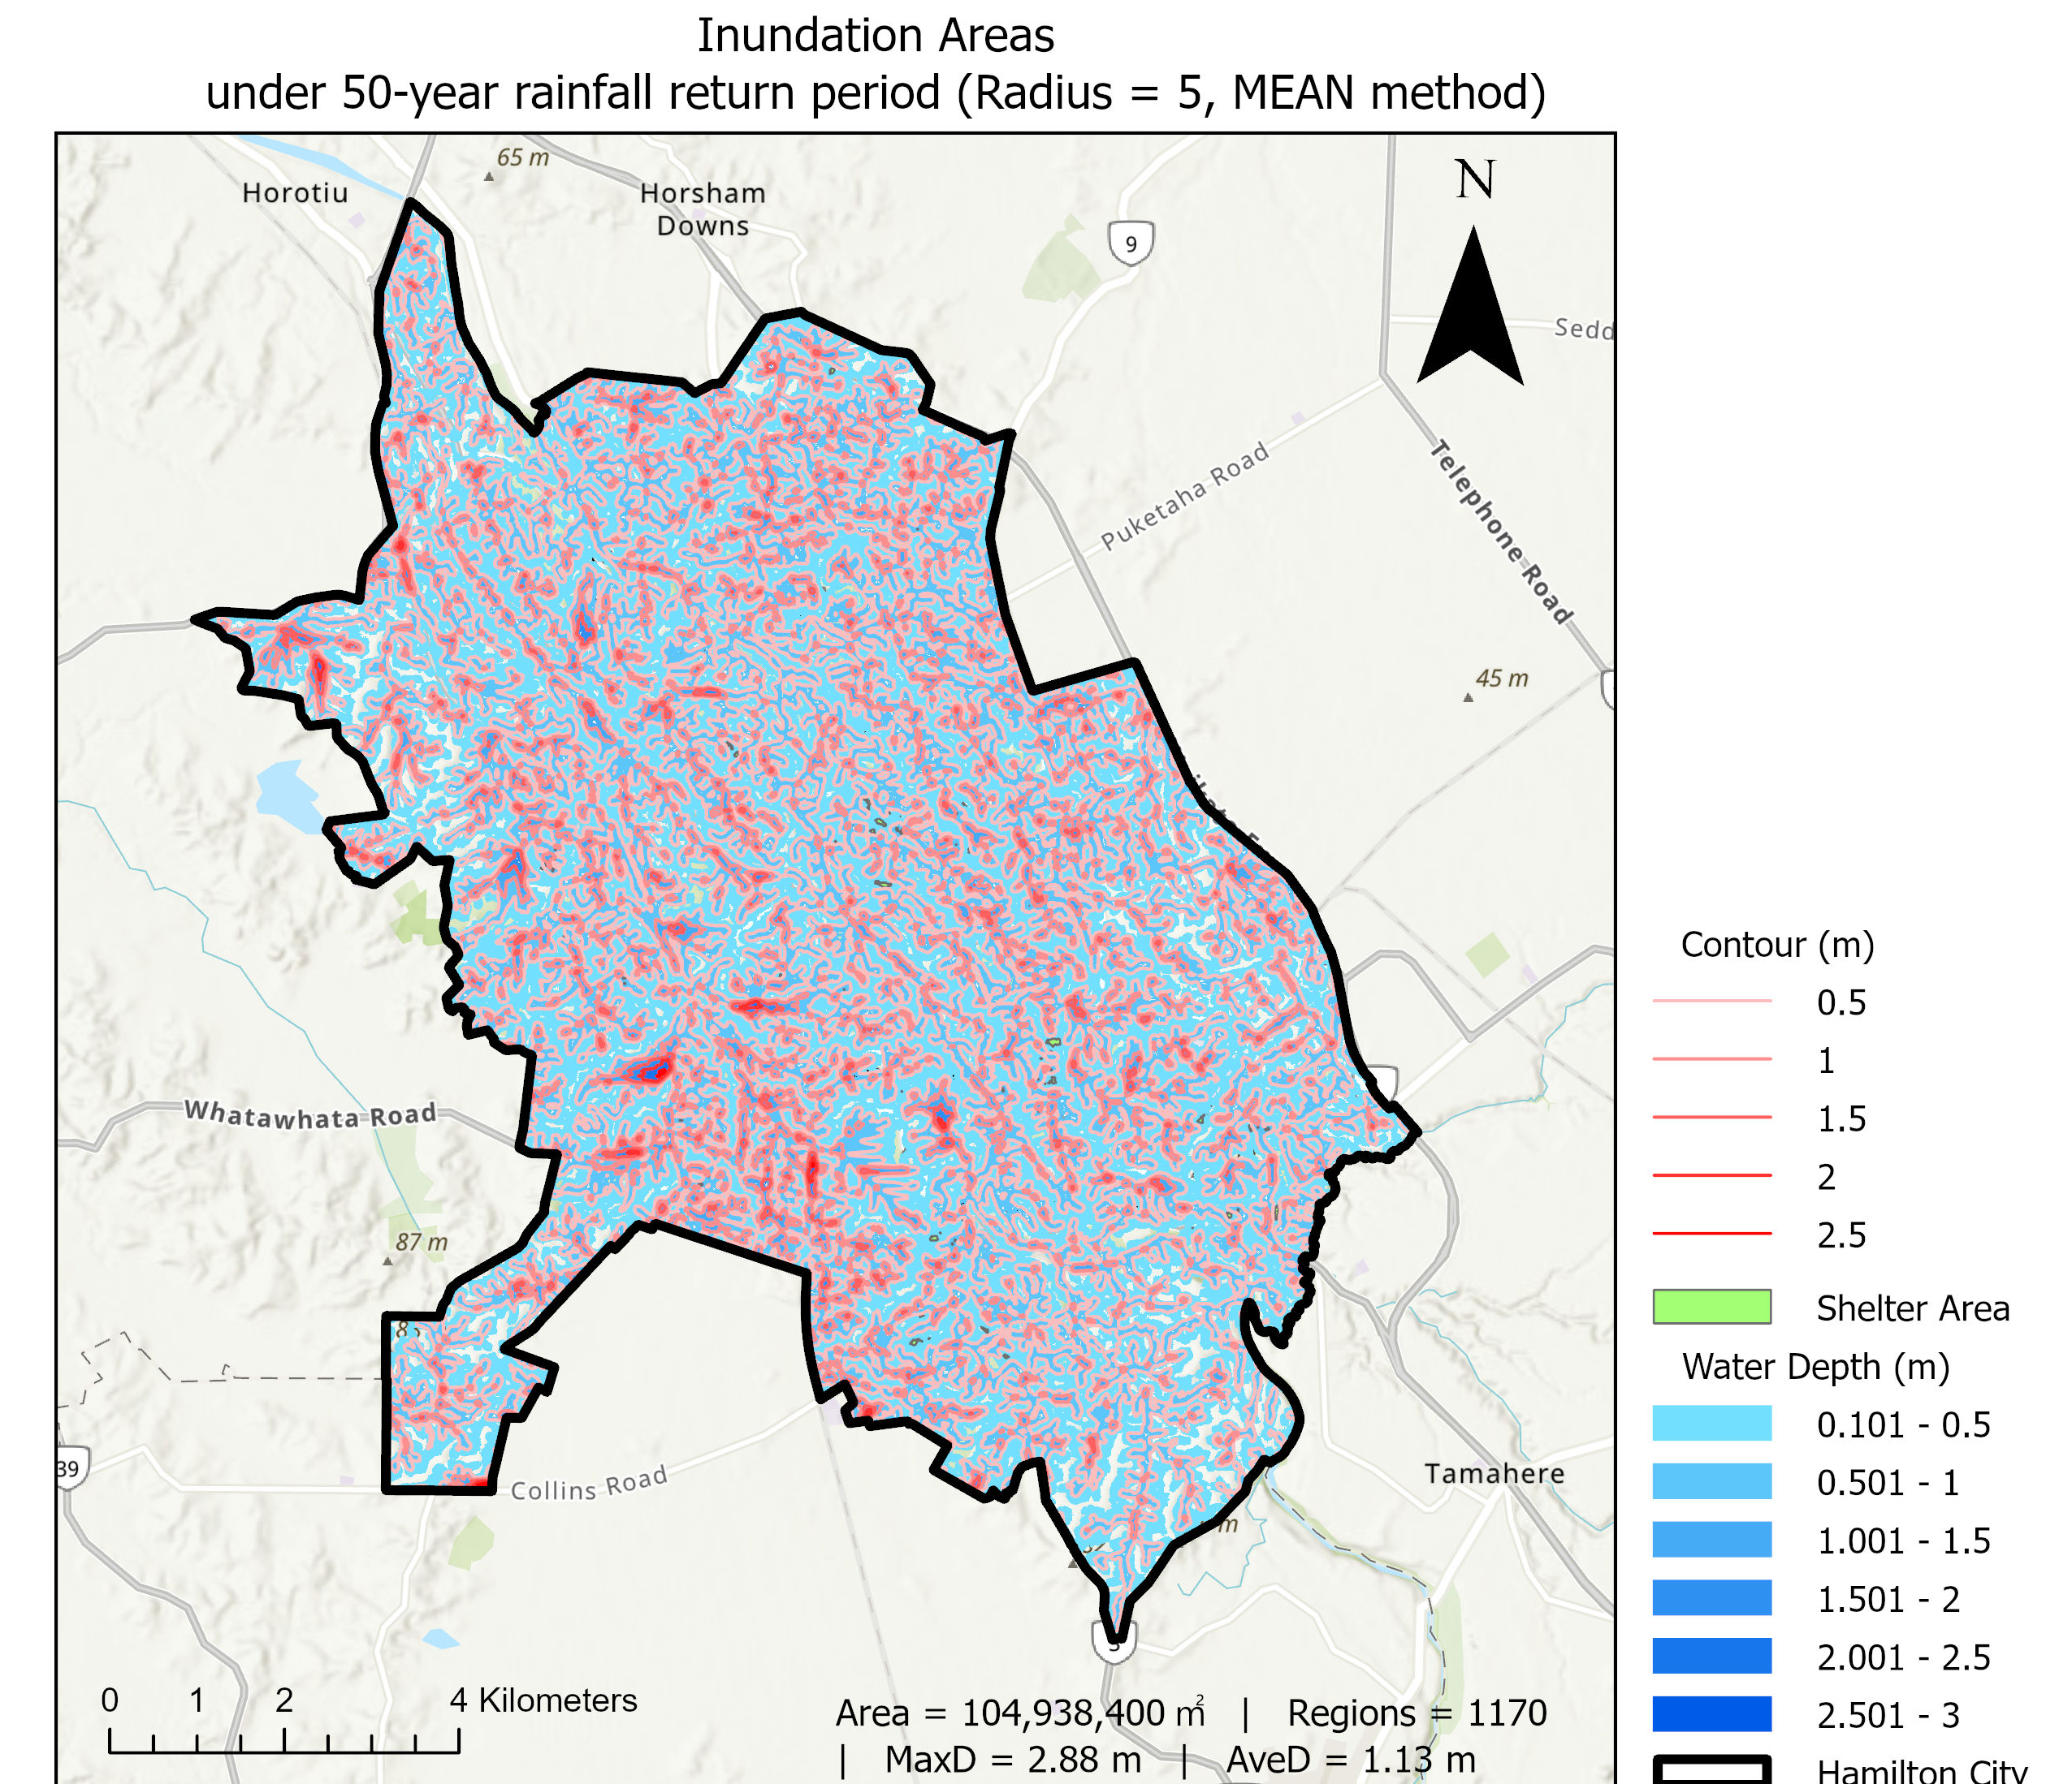
Flood Inundation Prediction under Extreme Rainfall Events in Hamilton City
When extreme rainfall occurs, where will flooding happen, and where can people go?
Introduction & Problem
Climate change is increasing the frequency and intensity of extreme weather events, including heavy rainfall (Ministry for the Environment, 2020). Hamilton City, with its flat terrain and urban expansion, is particularly vulnerable to flooding.
This raises an urgent question: “When extreme rainfall occurs, where will flooding happen, and where can people go?”
This project uses GIS to model flood-prone areas in Hamilton under 10-, 20-, and 50-year rainfall scenarios, estimate flood extent and depth, and identify safe shelter locations for emergency response and planning.
Key Results Summary
Extract information from tables (see Table 1) for comparative analysis
Rainfall Effect (see Figure 1 - 4): All indicators rise with increased rainfall—consistent with hydrological expectations.
Method Impact (see Figures 2 & 3): • MEAN → higher average depth & larger flood areas • MEDIAN → more fragmented, smaller regions
Radius Influence (see Figure 2): • Radius = 5 improves region connectivity vs. radius = 3
Anomaly (50-year) (see Figure 2) : • MEAN + radius = 5 → more regions than MEDIAN → indicates threshold sensitivity
→ Final Visualization Approach: Use Focal Statistics (radius = 5, MEAN) for clearer, more consistent urban flood risk mapping (see Map 1 - 3).
Figure 1. Total Inundation Area under Different Focal Statistics Methods
Figure 3: Average Water Depth under Different Focal Statistics Methods
Previous Research
Relevant studies informed both the modeling framework and parameter settings. Zheng et al. (2018) and Tran & Nguyen (2025) emphasized combining DEM, land cover, and soil data with weighted surface characteristics. Soliman et al. (2022) provided Manning’s n values for weight assignment.
A 10m DEM and Focal Statistics were adopted following Cohen et al. (2018). A 0.5m depth interval was applied for clearer flood visualization, based on Tran & Nguyen (2025). Schools and hospitals were selected as shelters, as recommended by Kar & Hodgson (2008).
Together, these studies provide the methodological foundation for the GIS-based flood inundation assessment, from simulation to visualization and planning.
Figure 2: Number of Inundation Regions under Different Focal Statistics Methods
Figure 4: Maximum Water Depth under Different Focal Statistics Methods
Table 1: Summary of Simulated Inundation Characteristics under Different Rainfall Scenarios and Focal Statistics Conditions
Map 1: Inundation areas under 10-year rainfall return period
Map 2: Inundation areas under 20-year rainfall return period
Map 3: Inundation areas under 50-year rainfall return period
Methodology
- Download the relevant datasets, including DEM, landcover, soil ,rainfall, facilities from “LINZ”, “NIWA”, “LRIS”, “STATS” websites - Resample DEM to smooth terrain-induced noise, Combine landcover and soil layers to create a weight layer used in Flow Accumulation - Simulate flow: Fill → Flow Direction → Accumulation - Multiply with rainfall (10-, 20-, 50-year) to estimate water depth - Apply Focal Statistics (radius = 3 or 5; MEAN or MEDIAN) to smooth the water depth - Extract flood areas (depth > 0.1m), apply Region Group, filter >1000 m² - Identify safe shelters using Erase tool on schools & hospitals
Limitations: - No sensitivity analysis on weight values - Urban drainage system not modeled - No accessibility analysis for shelters
Future Work:
- Use 1m LiDAR DEM to achieve more precise surface representation - Include dynamic rainfall and real drainage to ensure reliability - Validate with historical data to improve model stability - Add network-based shelter accessibility analysis to improve the realism and responsiveness of evacuation planning

